Slide 1

Operating Systems Design( 19CS2106S) Session-5 & 6 Revision

Slide 2
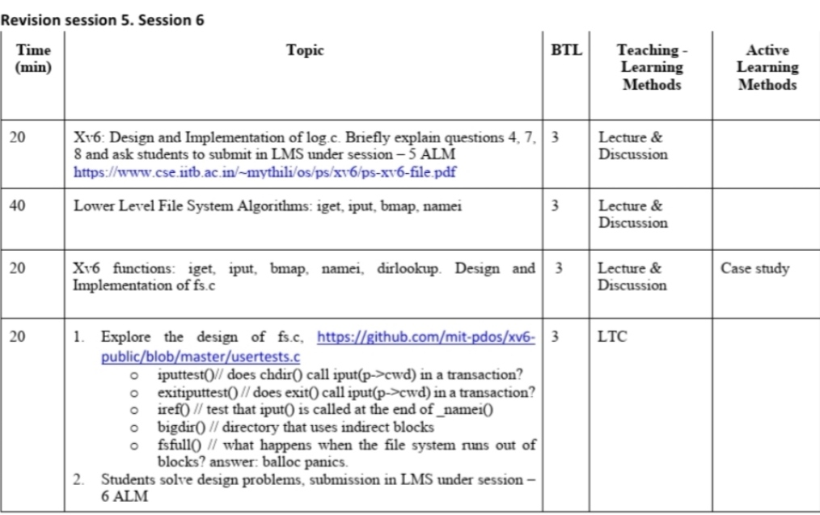
Session Plan

Slide 3
Design and Implementation of log.c (10 mnts)
https://github.com/mit-pdos/xv6-public/blob/master/log.c

Slide 4
Logging –Crash Recovery in File Systems
Crash Recovery is one of the issue in File Systems.
This issue arises when many file system operations involve multiple writes to the disk.
This may result in a crash after a subset of the writes may leave the on-disk file system in an inconsistent state.
This problem can be solved using log based recovery.
Log is a sequence of records of write activities and maintains a history of all update activities.

Slide 5
How xv6 solves the crash problem?
Xv6 solves the problem of crashes during file system operations with a simple form of logging.
An xv6 system call does not directly write the on-disk file system data structures.
Instead, it places a description of all the disk writes it wishes to make in a log on the disk.
Once the system call has logged all of its writes, it writes a special commit record to the disk indicating that the log contains a complete operation.
Then the system call copies the writes to the on-disk file system data structures.
After those writes have completed, the system call erases the log on disk.

Slide 6
Log based crash recovery
If the system should crash and reboot, the file system code recovers from the crash as follows, before running any processes.
If the log is marked as containing a complete operation, then the recovery code copies the writes to where they belong in the on-disk file system.
If the log is not marked as containing a complete operation, the recovery code ignores the log.
The recovery code finishes by erasing the log.

Slide 7
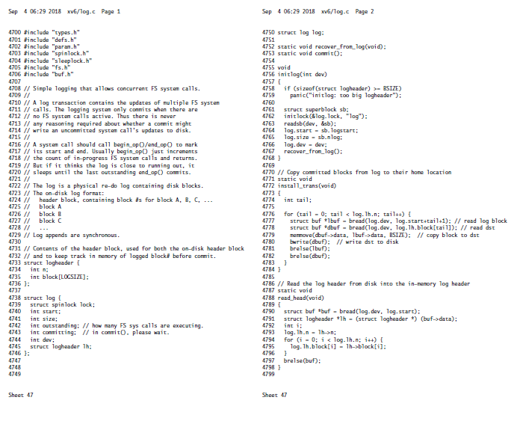
log.c-Sheet No.47 from xv6 Code Manual

Slide 8
Discussion of ALMs
https://www.cse.iitb.ac.in/~mythili/os/ps/xv6/ps-xv6-file.pdf

Slide 9
Session-5 ALM-1
Consider two processes in xv6 that both wish to read a particular disk block, i.e., either process does not intend to modify the data in the block. The first process obtains a pointer to the struct buf using the function “bread”, but never causes the buffer to become dirty.
Now, if the second process calls “bread” on the same block before the first process calls ”brelse”, will this second call to “bread” return immediately, or would it block? Briefly describe what xv6 does in this case, and justify the design choice.

Slide 10
Session-5 ALM-2
When the buffer cache in xv6 runs out of slots in the cache in the bget function, it looks for a clean LRU block to evict, to make space for the new incoming block.
What would break in xv6 if the buffer cache implementation also evicted dirty blocks (by directly writing them to their original location on disk using the bwrite function) to make space for new blocks?

Slide 11
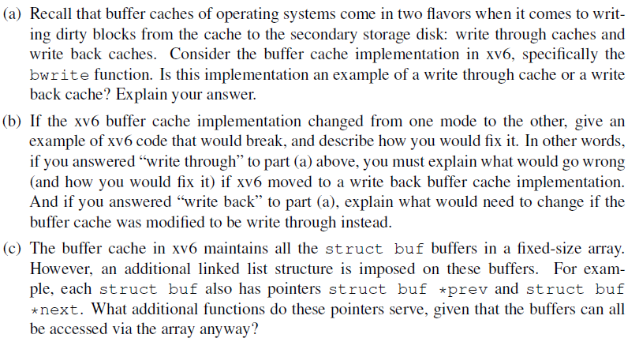
Session-5 ALM-3

Slide 12
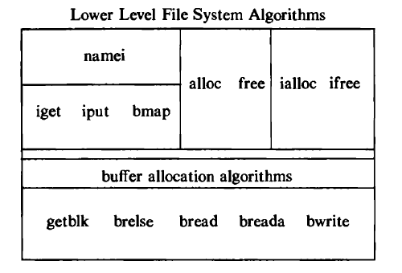
Low-level File System Algorithms

Slide 13
iget
iget
bmap
namei

Slide 14
Review of inode
inode stands for index node.
In Unix based operating system each file is indexed by a number called inode(index node) or inode number.
It’s a name of a file in the form a number.
The inode contains the information necessary for a process to access a file, such as file ownership, access rights, file size, and location of the file's data in the file system.
inode contains the table of contents to locate a file's data on disk.
Also called as disk inode.

Slide 15
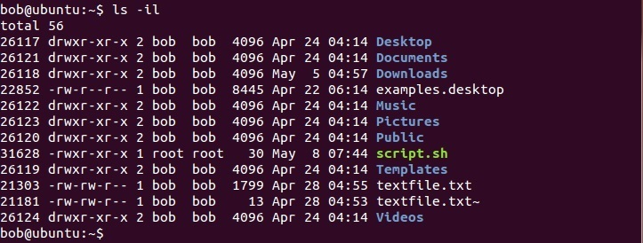
inode number can be viewed using the ls -il command

Slide 16
Concept of in-core inode
When the file is opened, then the kernel copies the inode(disk inode) into main memory area called inode cache, just likie the buffer cache.
So, this copy of disk inode present in MM is called as in-core inode.
As the file changes, the in-core inode is updated usually more often than the on-disk copy.
The in-core inode contains up-to-date information on the state of the file
This is allocation is done using iget algorithm

Slide 17
Accessing of inode
Accessing of inode is similar to the concept of accessing a buffer block in Buffer Cache.
Here also the concept Hash Queue and FREE LIST will be there.
The kernel maps the device number and inode number into a hash queue and searches the queue for the inode.
If it cannot find the inode, it allocates one from the free list and locks it.
The kernel then prepares to read the disk copy of the newly accessed inode into the in-core copy.

Slide 18
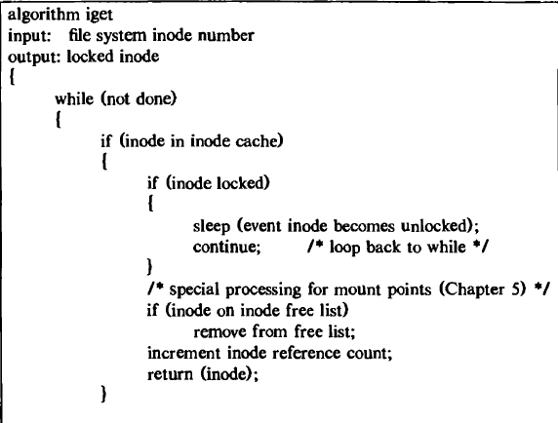
Allocation of an in-core copy of actual disk inode iget Algorithm

Slide 19
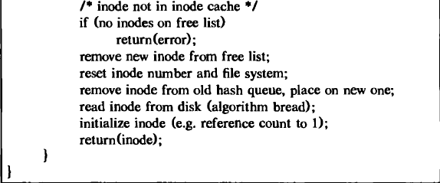
Allocation of an in-core copy of actual disk inode iget Algorithm

Slide 20
The kernel removes the in-core inode from the free list, places it on the correct hash queue, and sets its in-core reference count to 1.
It copies the file type, owner fields, permission settings, link count, file size, and the table of contents from the disk inode to the in-core inode, and returns a locked inode.

Slide 21
Releasing the inodes
When the kernel releases an inode ,it decrements its in-core reference count.
If the count drops to 0, the kernel writes the inode to disk if the in-core copy differs from the disk copy.
They differ if the file data has changed like if the file access time has changed, or if the file owner or access permissions have changed.
Now, the kernel places the inode on the free list of inodes, effectively caching the inode in case it is needed again soon.
The kernel may also release all data blocks associated with the file and free the inode if the number of links to the file is 0.

Slide 22
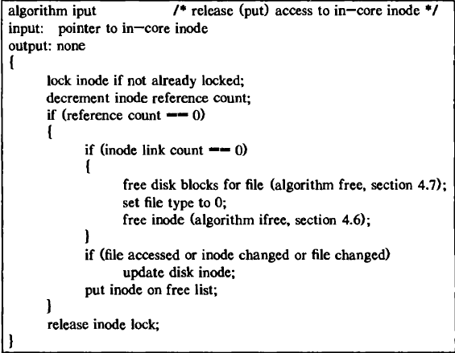
Releasing the inodes using iput algorithm

Slide 23
Structure of Regular File
In UNIX, the data in files is not stored sequentially on disk. If it was to be stored sequentially, the file size would not be flexible without large fragmentation.
In case of sequential storage, the inode would only need to store the starting address and size.
Instead, the inode stores the disk block numbers on which the data is present.
But for such strategy, if a file had data across 1000 blocks, the inode would need to store the numbers of 1000 blocks and the size of the inode would differ according to the size of the file.

Slide 24
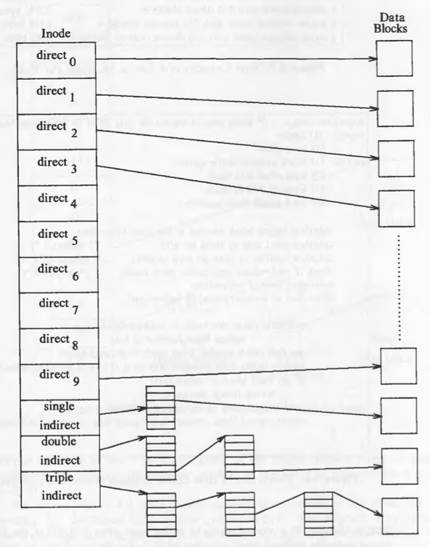
Structure of a Regular File in Unix

Slide 25
The inodes have array of size 13 which for storing the block numbers, although, the number of elements in array is independent of the storage strategy.
The first 10 members of the array are "direct addresses", meaning that they store the block numbers of actual data.
The 11th member is "single indirect", it stores the block number of the block which has "direct addresses".

Slide 26
The 12th member is "double indirect", it stores block number of a "single indirect" block.
And the 13th member is "triple indirect", it stores block number of a "double indirect" block.
This strategy can be extended to "quadruple" or "quintuple" indirect addressing.

Slide 27

If a logical block on the file system holds 1K bytes and that a block number is addressable by a 32 bit integer, then a block can hold up to 256 block numbers. The maximum file size with 13 member data array is:

Slide 28
But the file size field in the inode is 32 bits, the size of a file is effectively limited to 4 gigabytes.

Slide 29
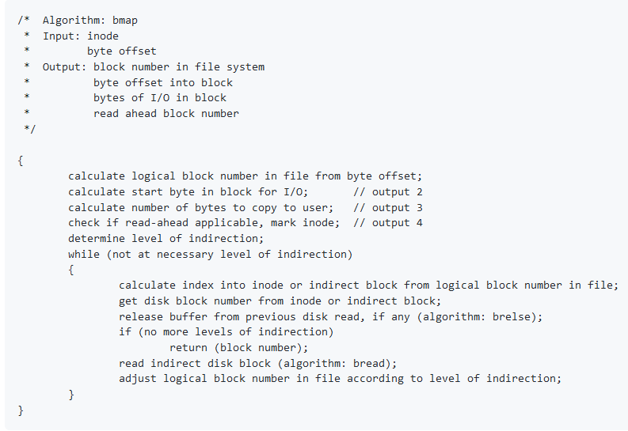
bmap- to convert logical byte offset of a file to a physical disk block

Slide 30
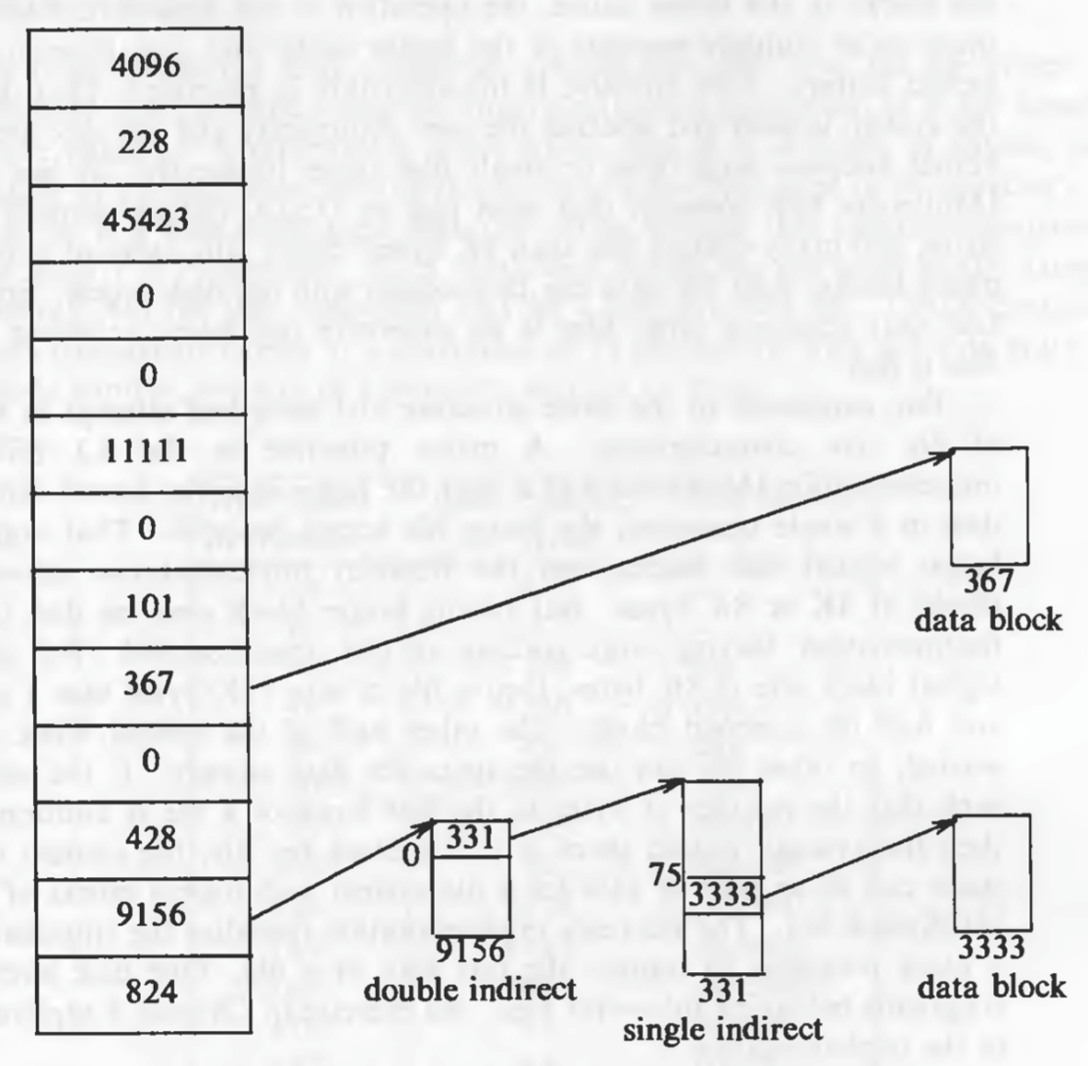
Example

Slide 31
To access byte offset 9000: The first 10 blocks contain 10K bytes. So 9000 should be in the first 10 block. 9000 / 1024 = 8 so it is in the 8th block (starting from 0). And 9000 % 1024 = 808 so the byte offset into the 8th block is 808 bytes (starting from 0). (Block 367 in the figure.)

Slide 32
Directories
Directories are the set of files that gives the file system its hierarchical structure.
A directory is a file whose data is a sequence of entries, each consisting of an inode number and the name of a file contained in the directory.
A path name is a null terminated character string divided into separate components by the slash ("/") character.
Each component except the last must be the name of a directory, but the last component may be a non-directory file

Slide 33
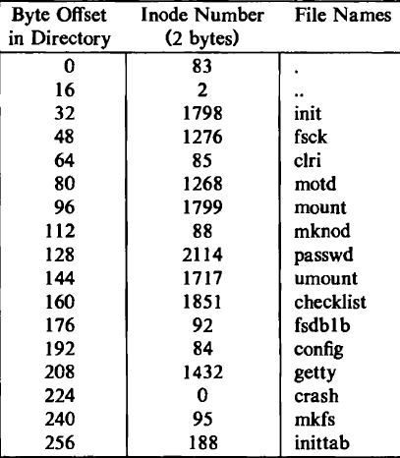
Directory layout for /etc

Slide 34
Directory entries may be empty, indicated by an inode number of 0.
For instance, the entry at address 224 in "/etc" is empty, although it once contained an entry for a file named "crash".

Slide 35
Every directory contains the file names dot and dot-dot ("." and "..") whose inode numbers are those of the directory and its parent directory, respectively.
The inode number of "." in "/etc“ is located at offset 0 in the file, and its value is 83.
The inode number of ".." is located at offset 16, and its value is 2.

Slide 36
Accessing a file in directory using path name
namei algorithm is used for Conversion of a path name to an inode.
It searches a pathname until a terminal point is found .
The access to a file in a directory is by its path name,but the kernel works internally with inodes only rather than with path names.
Therefore, it converts the path names to inodes to access files

Slide 37
namei Algorithm-Searching the path
namei algorithm uses intermediate inodes as it parses a path name; call them working inodes.
The inode where the search starts is the first working inode.
During each iteration of the namei loop, the kernel makes sure that the working inode is indeed that of a directory.
Otherwise, the system would violate the assertion that non-directory files can only be leaf nodes of the file system tree.
The process must also have permission to search the directory (read permission is insufficient).

Slide 38
namei Algorithm
The user ID of the process must match the owner or group ID of the file, and execute permission must be granted, or the file must allow search to all users.
Otherwise the search fails.

Slide 39
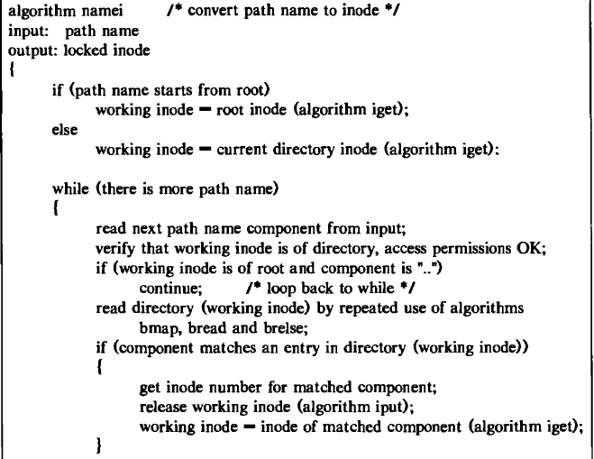
namei Algorithm

Slide 40
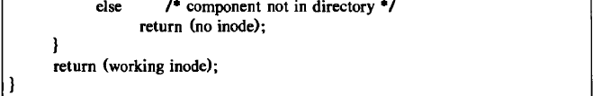
namei Algorithm

Slide 41
Case Study of fs.c
fs.c file is available from code sheets 49-57 in xv6 code sheet manual.
It presents the implementation code in xv6 for the iget, bget, bmap, namei and dirlookup low level file system algorithms.

Slide 42
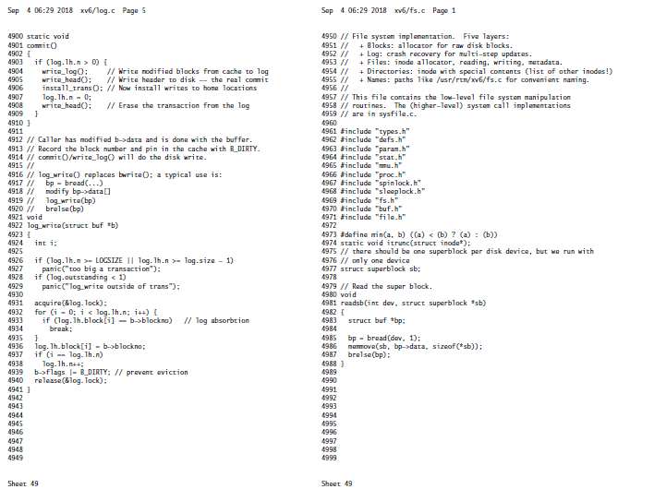
Xv6 Code Sheet No.49

Slide 43
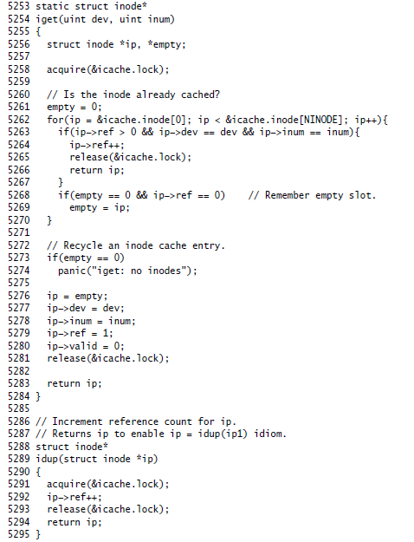
iget

Slide 44
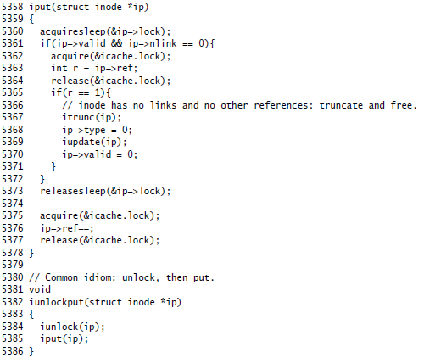
iput

Slide 45
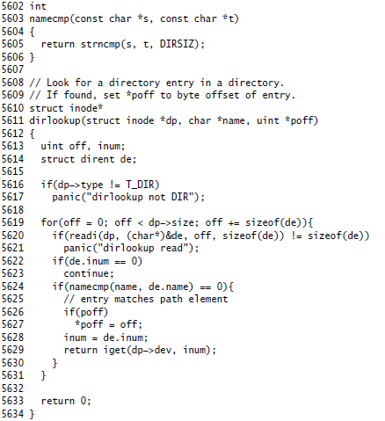
dirlookup

Slide 46
LTC Activities-Session-6
Program to demonstrate the following
iputtest()// does chdir() call iput(p->cwd) in a transaction?
exitiputtest() // does exit() call iput(p->cwd) in a transaction?
iref() // test that iput() is called at the end of _namei()
bigdir() // directory that uses indirect blocks
fsfull() // what happens when the file system runs out of blocks? answer: balloc panics. */

Slide 47
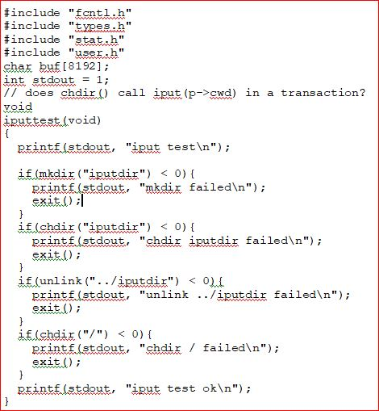
LTC Activity-Testing iput

